Slide 1
Financial Performance Dashboard
By Devkankshi Prasad
Unified mentor – data science internship

Slide 2
Project overview
Built an interactive Tableau dashboard to analyze key financial metrics including:
• Sales
• Profit
• Cost of Goods Sold (COGS)
• Discounts
across multiple dimensions such as category, region, and time.

Slide 3
Dataset summary
Source: Order-level transactional data.
Metrics: Sales, Profit, COGS, Discounts
Dimensions: Region, Category, Sub-Category, Order Date
Time Frame: Monthly/Quarterly financial analysis

Slide 4
Visualizations created
Tree Map – Profit by product and segment
Sales Map – Country wise gross sales
Area Chart – Cumulative sales over time
Dual Axis Line Chart – Discount vs profit
Box Plot – Profit distribution by product

Slide 5
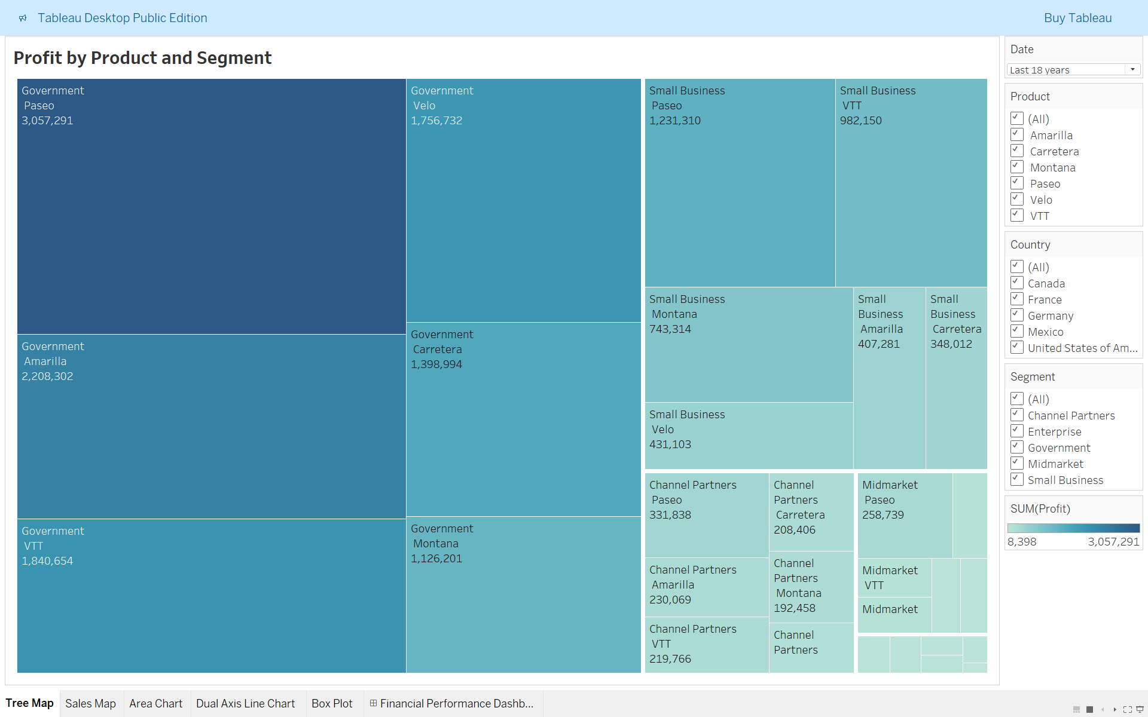
Tree map
• Visualizes profit contribution by product and customer segment.
• Larger blocks represent higher profit items, enabling quick identification of top performers.

Slide 6
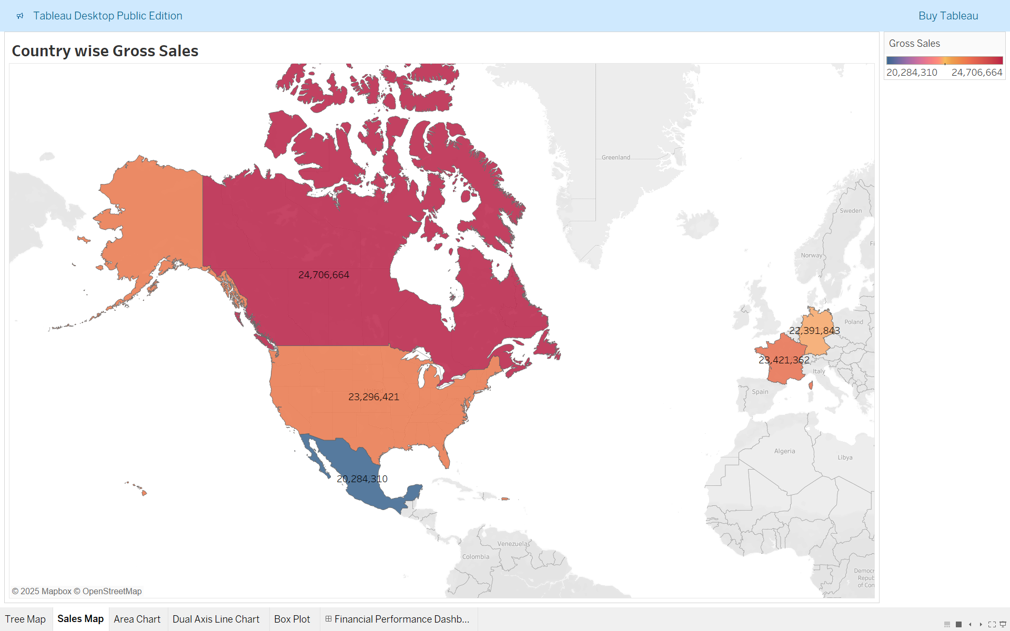
Sales map
• Geographic map showing total sales across countries.
• Helps identify high-revenue markets and potential growth areas

Slide 7
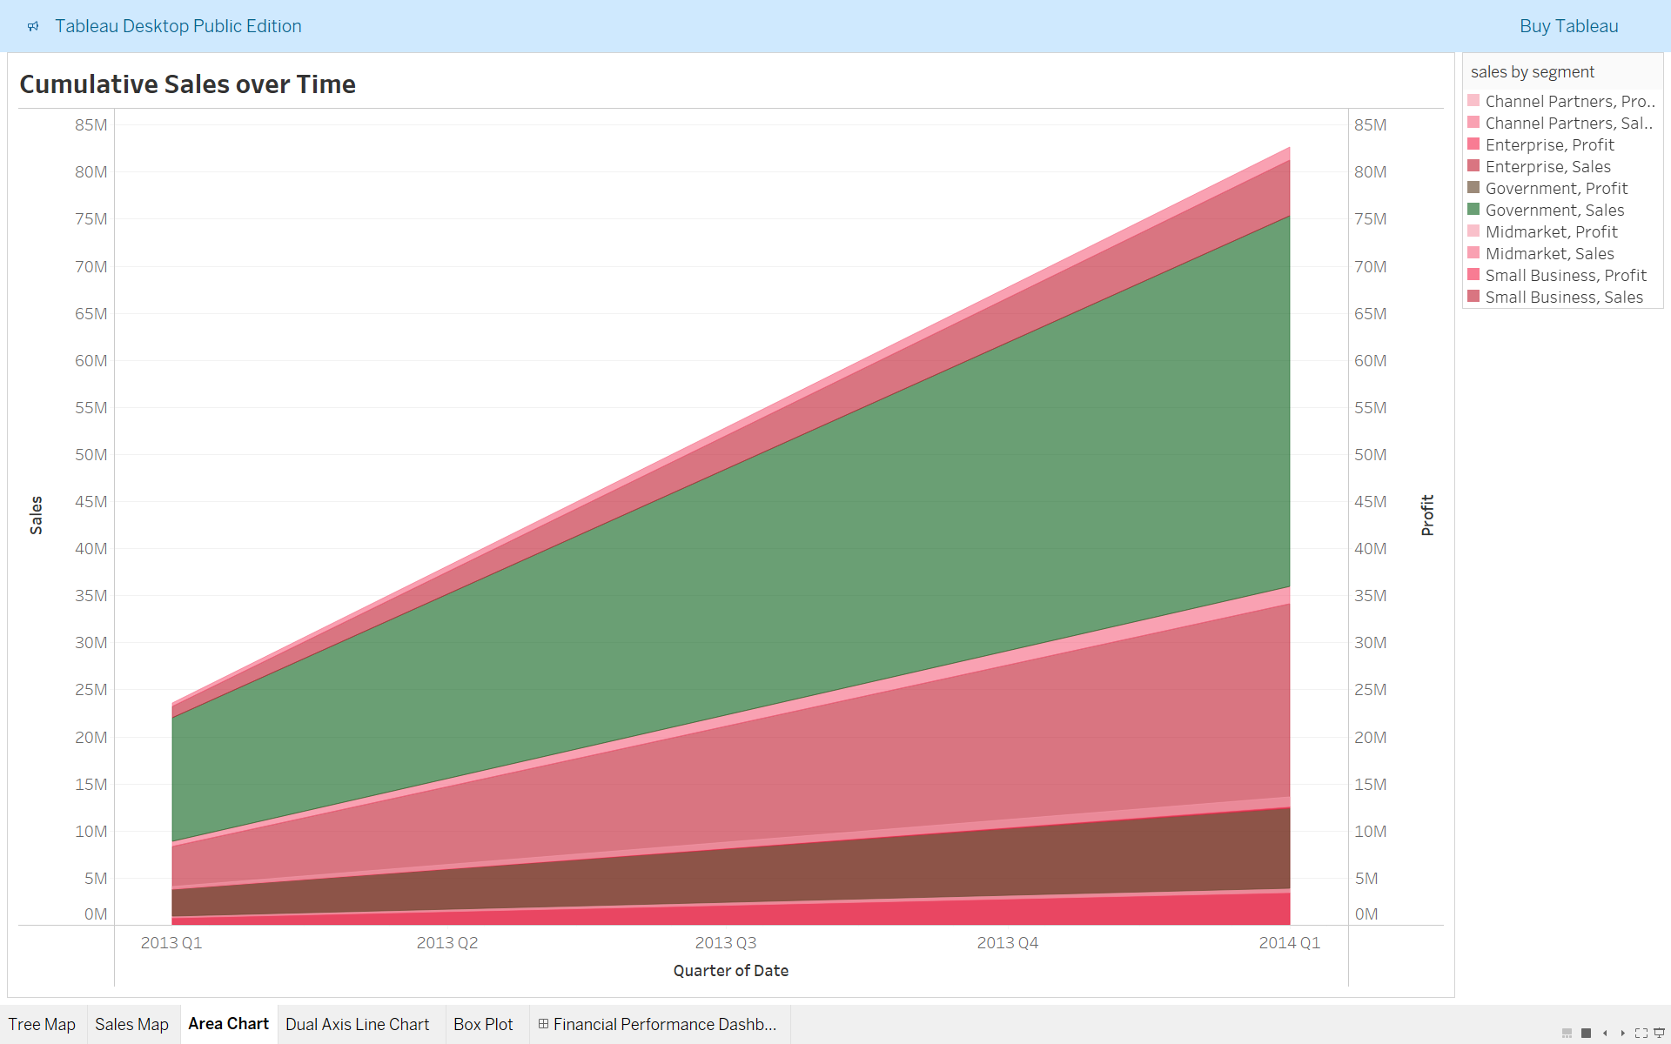
Area chart
• Displays cumulative sales progression month-over-month.
• Useful for understanding overall revenue momentum and growth trajectory.

Slide 8
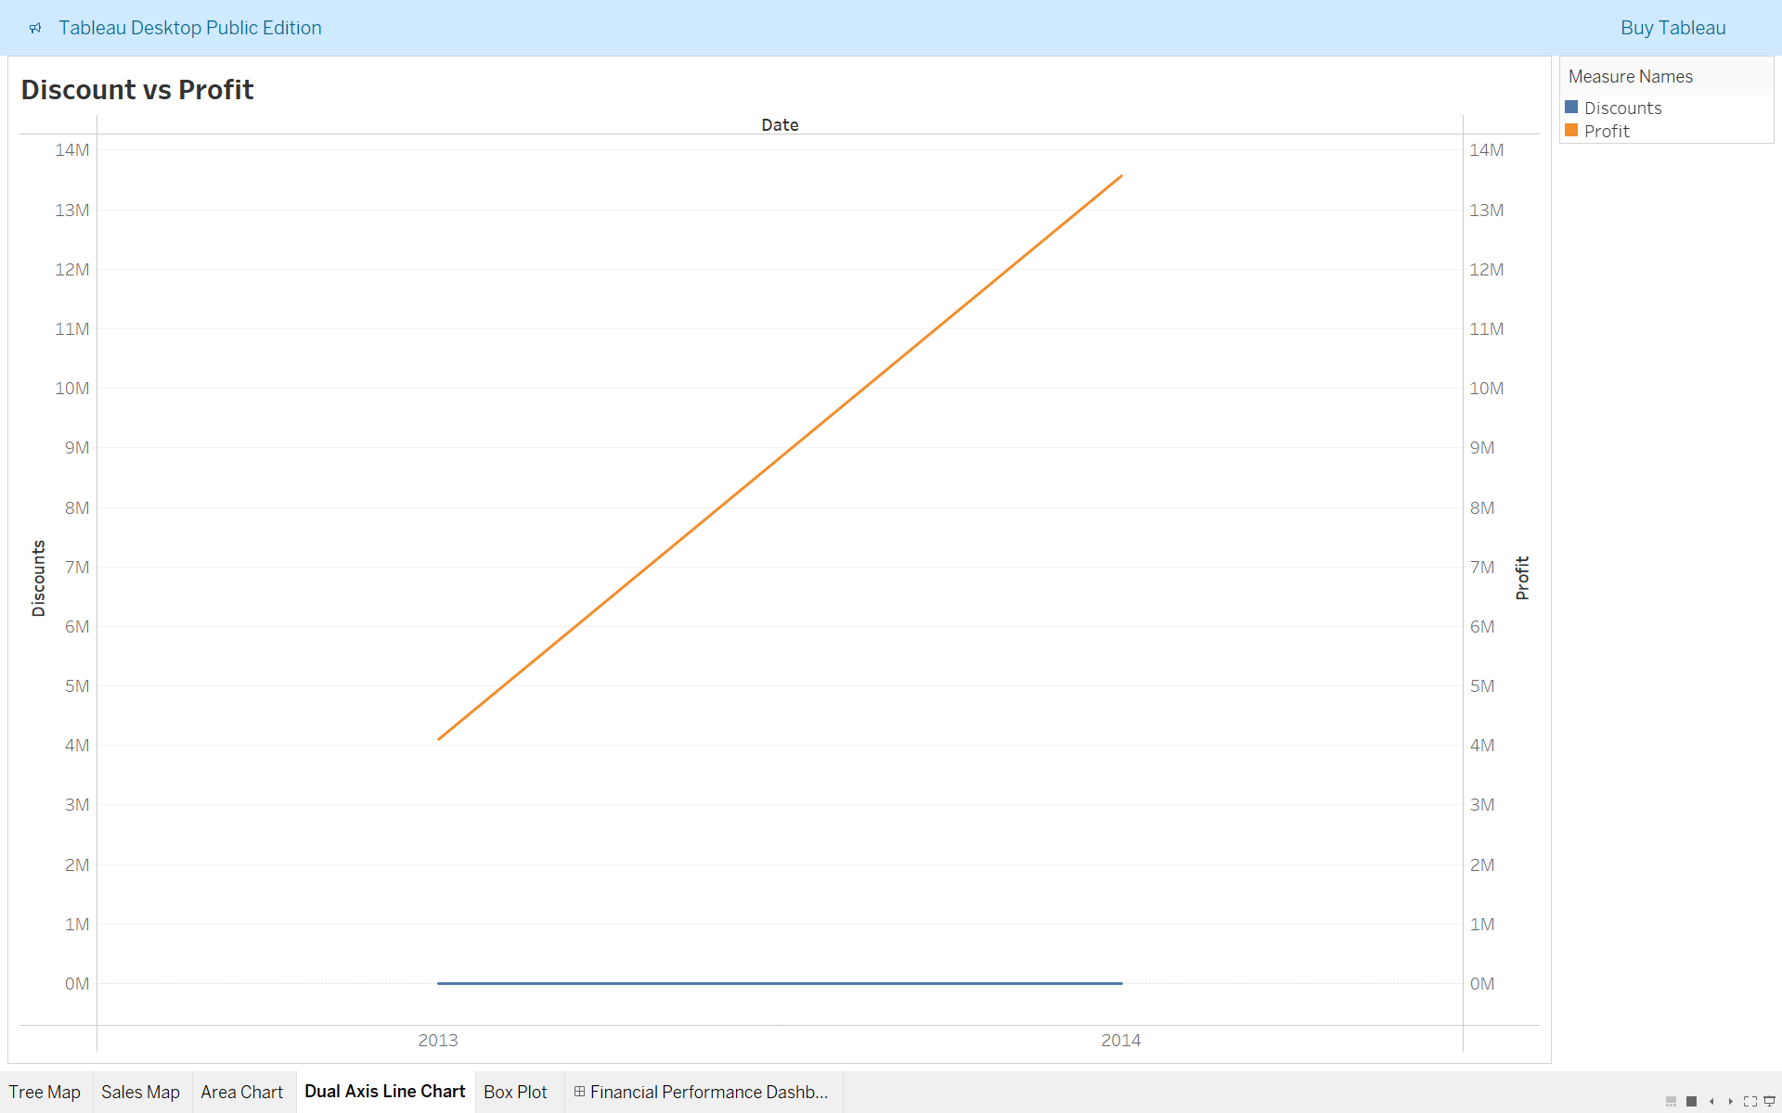
Dual axis line chart
• Compares trends of discount percentage and profit on the same timeline.
• Reveals how excessive discounting can impact profitability.

Slide 9
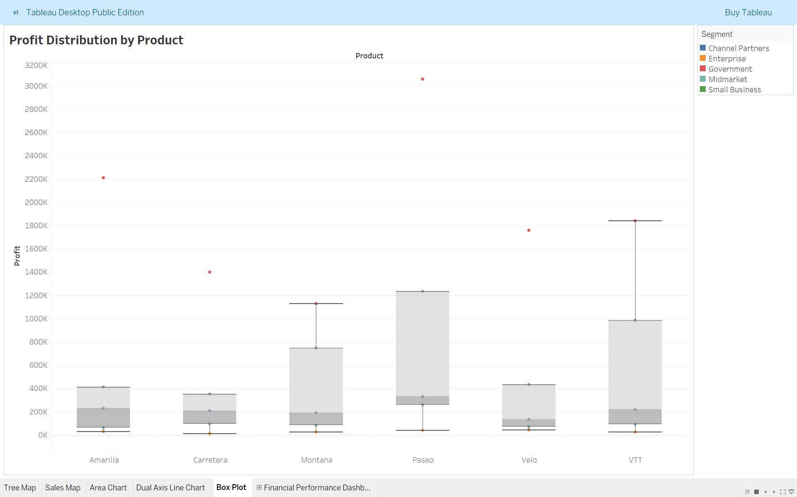
Box plot
• Shows spread, median, and outliers in product-level profit data.
• Useful for identifying inconsistent performers or risky products.

Slide 10
Filters and interactivity
Dashboard Filters:
• Region (East, West, Central, South)
• Category / Sub-category
• Time Period (Year/Month filter)
Interactivity Features:
• Hover tooltips for precise values
• Drill-down into sub-categories and order-level details

Slide 11
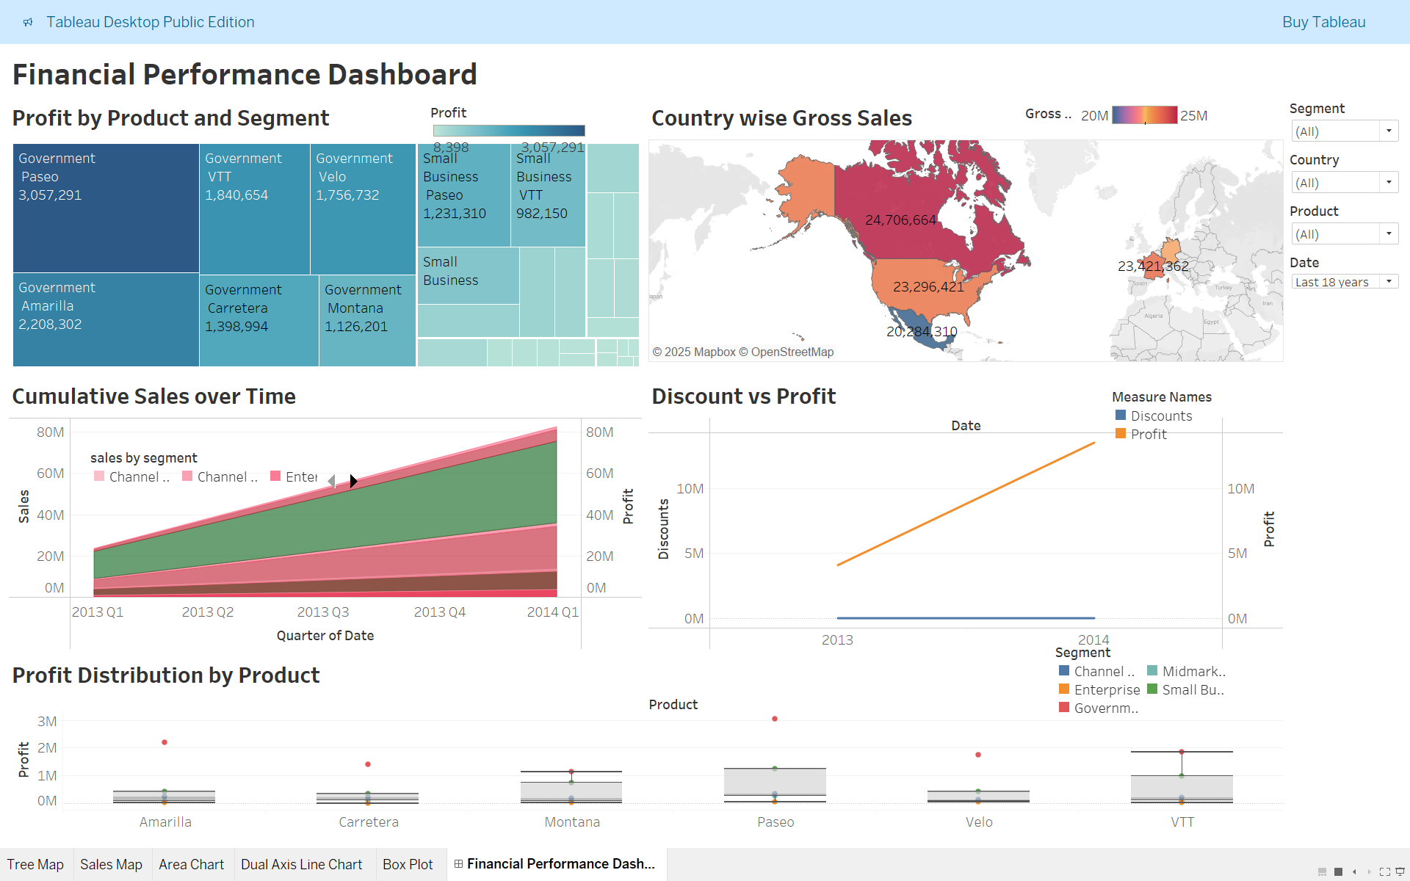
Dashboard
The dashboard brings together key financial visuals with interactive filters for time, region, and category. It enables:
• Instant KPI monitoring
• Deeper profit and discount analysis
• Country-level sales visibility
• Product-wise performance evaluation
Supporting data-driven decisions across business units.

Slide 12
Key insights
Technology drives highest profit margins.
West region leads in total sales.
Discount-heavy sub-categories reduce overall profit.
Central region shows balanced sales and margin ratio.

Slide 13
Business impact
Enables real-time financial tracking.
Helps identify high-performing regions and categories.
Informs discount optimization strategies.
Facilitates better financial planning and forecasting.

Slide 14
Challenges faced
Maintaining dashboard performance with large data
Creating responsive visual hierarchy
Balancing interactivity with simplicity

Slide 15
Conclusion and learnings
Gained hands-on experience with Tableau.
Transformed raw data into interactive business insights.
Learned importance of KPI-focused dashboards.

Slide 16
Thank you
Looking forward to your feedback.
Happy to demonstrate the dashboard live if needed.

